Slide 1
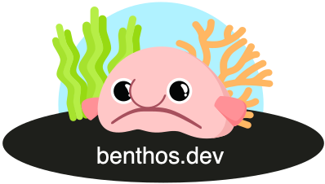

Gophers guide to Data Streaming at Scale with Benthos
Mihai Todor
23.11.2021
Joint GoSF ✈ GolangNYC Meetup

Slide 2
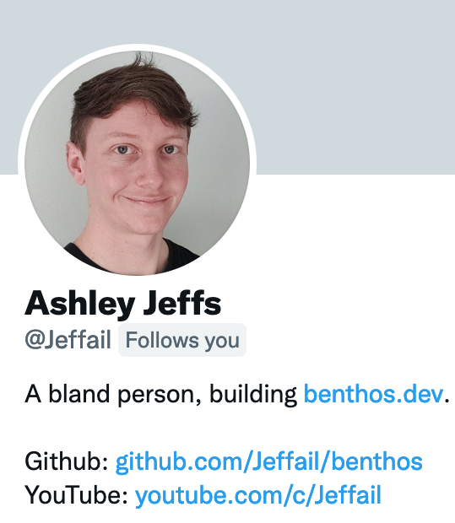
Disclaimers
Thoughts expressed here are my own
Benthos is owned and maintained by Ash: https://twitter.com/Jeffail/
Ash designed and built Benthos from scratch
I help out and send PRs occasionally

Slide 3

What is Benthos? https://www.benthos.dev/
Hint: It has nothing to do with deep sea fish, except for the logo

Slide 4
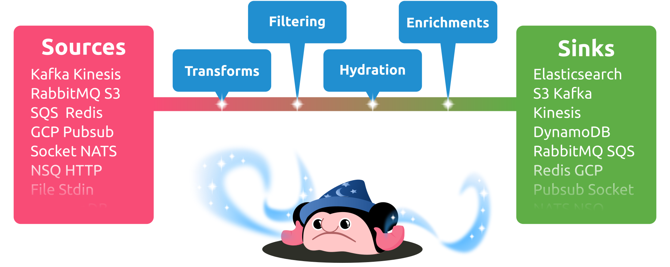
What is Benthos for?
“Fancy stream processing made operationally mundane” - Ash Jeffs

Slide 5


Podcasts
Go Time Podcast episode #192: https://changelog.com/gotime/192
What is Data Streaming?
The Data Stack Show Podcast episode #60: https://datastackshow.com/podcast/architecting-a-boring-stream-processing-tool-with-ashley-jeffs-of-benthos/
Project history

Slide 6

Boringly easy to use
# Install
curl -Lsf https://sh.benthos.dev | bash
# Make a config
benthos create stdin/bloblang/stdout > ./config.yaml
# Run
benthos -c ./config.yaml

Slide 7

Features
Declarative YAML-based configuration
Single message transforms
Stateless
At least once delivery
Metrics and logging
Custom Plugins
Written in Go

Slide 8

Bloblang
root.new_doc = match this.doc {
this.type == "article" => this.article
this.type == "comment" => this.comment
_ => this
}
Custom DSL for arbitrary data transforms
{
"doc": {
"type": "article",
"article": {
"id": "foo",
"content": "qux"
}
}
}
{
"new_doc": {
"id": "foo",
"content": "qux"
}
}

Slide 9


Deployment models
Standalone CLI app
Serverless
Kubernetes

Slide 10

Importing Benthos as a library
> go get github.com/Jeffail/benthos/v3/public/components/all
package main
import (
"context"
"github.com/Jeffail/benthos/v3/public/service"
// Import all standard Benthos components
_ "github.com/Jeffail/benthos/v3/public/components/all"
)
func main() {
service.RunCLI(context.Background())
}

Slide 11
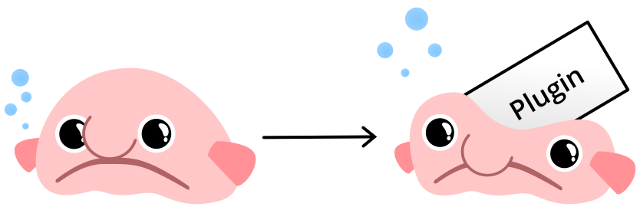
Writing a custom Benthos plugin
type processor struct{}
func (r *processor) Process(ctx context.Context, m *service.Message) (service.MessageBatch, error) {
println("foobar")
return nil, nil
}
func (r *processor) Close(ctx context.Context) error { return nil }
func init() {
_ = service.RegisterProcessor("foobar",
service.NewConfigSpec(),
func(conf *service.ParsedConfig, mgr *service.Resources) (service.Processor, error) {
return &processor{}, nil
},
)
}
// ./plugin create stdin/foobar/stdout > config.yaml
// ./plugin -c config.yaml

Slide 12


Future enhancements and goodies
More adapters
Custom plugins
Benthos Studio

Slide 13
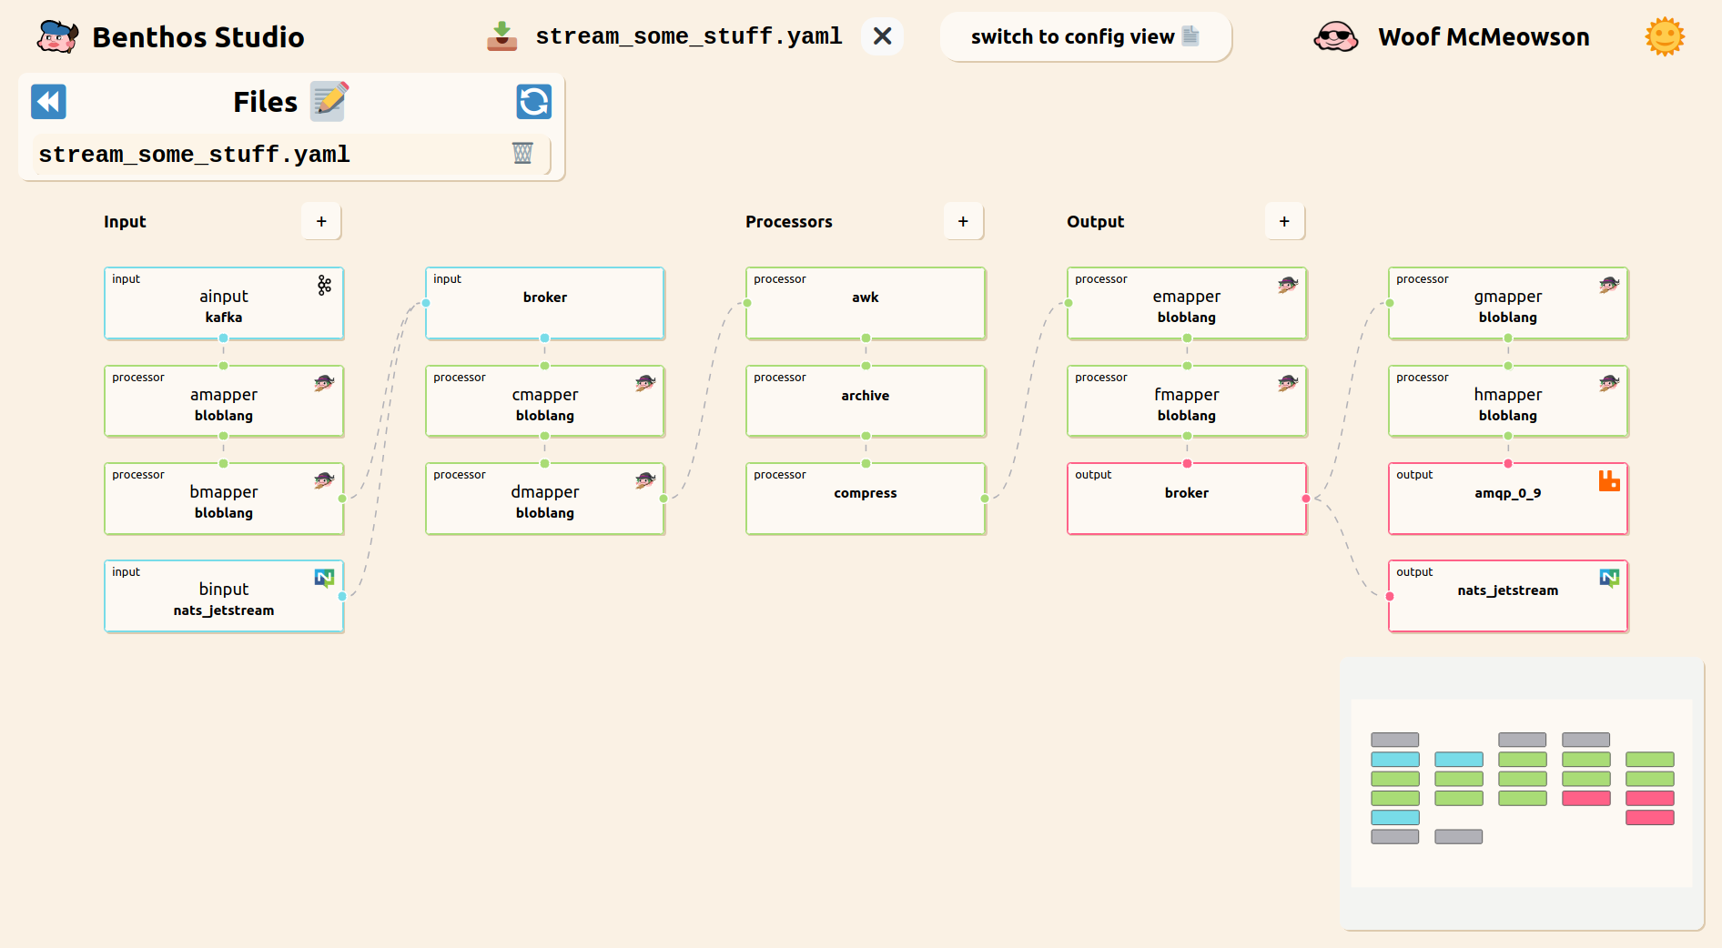

Slide 14
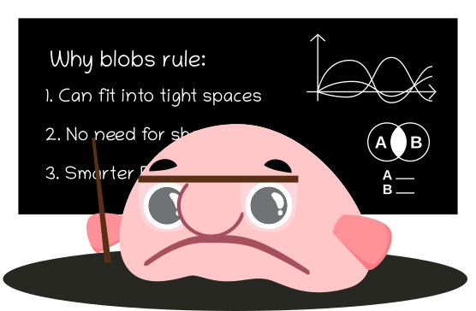
Why Open Source?
Built on the shoulders of giants
Community-driven features, enhancements and bug fixes
High quality standards enforced uniformly
Open issue tracker and permanent change history
Avoids vendor-driven lock-in

Slide 15

Open Source Needs You!

Slide 16



Community https://www.benthos.dev/community
https://discord.gg/6VaWjzP
https://invite.slack.golangbridge.org
#benthos channel

Slide 17




Optum’s hiring!
DB Babjack
Open Source
Aaron Strey
Data Mesh
Kate Agnew
Observability

Slide 18

Thank you!
https://www.linkedin.com/in/mtodor/
https://twitter.com/MihaiTodor
https://github.com/mihaitodor

